Slide 1
Skin-Lesion Analysis: Three Proposals for the Decade
Eduardo Valle
RECOD Lab
University of Campinas, UNICAMP, Brazil

Slide 2
The State of Affairs
Workflows
Alignment
Reliability & Robustness
Perspectives

Slide 3
The State of Affairs

Slide 4
classical global descriptors & models
deep neural networks
1990s:
Image Processing Era
2000s:
Computer Vision Era
2010s:
Machine Learning Era
2020s:
?
local descriptors & bags of visual words
curated datasets & challenges

Slide 5
classical global descriptors & models
increased interest
deep neural networks
attempts at
real-world
deployment
1990s:
Image Processing Era
2000s:
Computer Vision Era
2010s:
Machine Learning Era
2020s:
?
first prototypes,
proofs-of-concept
local descriptors & bags of visual words
curated datasets & challenges
curated datasets & challenges

Slide 6
Main Case Studies
Radiography & Tomography
Chest
Brain
Eye fundus
Mammography
Pathology slides
Dermoscopy and clinical dermophotography

Slide 7
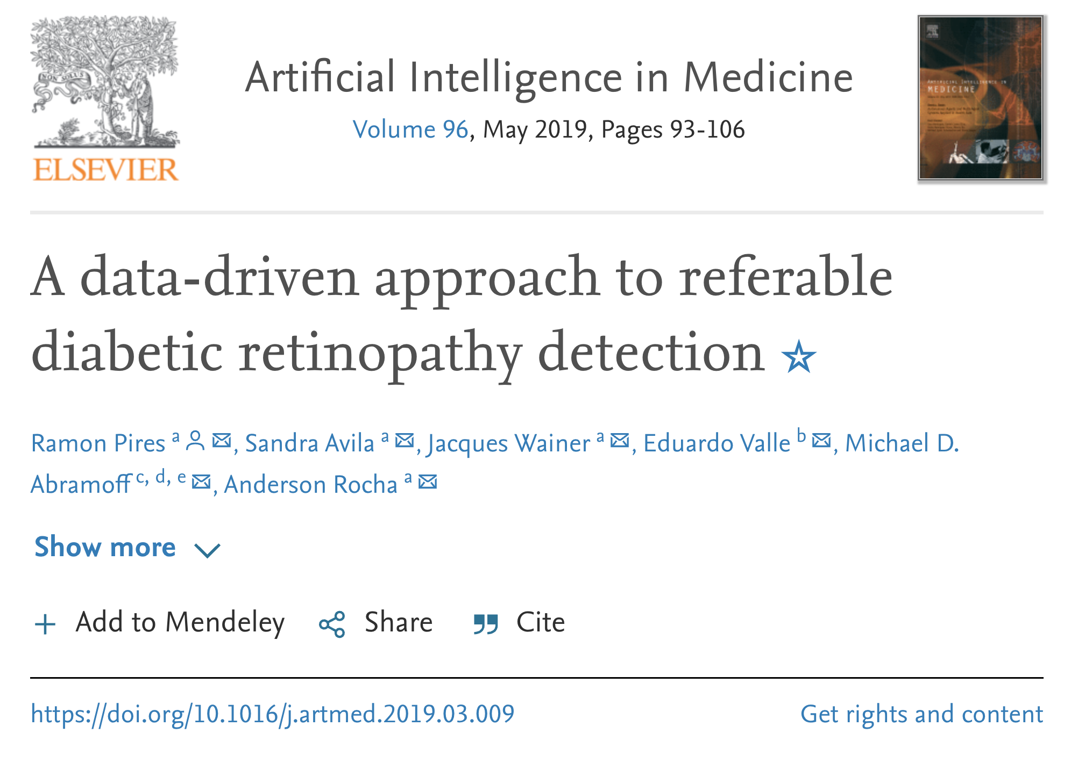
Main Case Studies
Radiography & Tomography
Chest
Brain
Eye fundus
Mammography
Pathology slides
Dermoscopy and clinical dermophotography

Slide 8
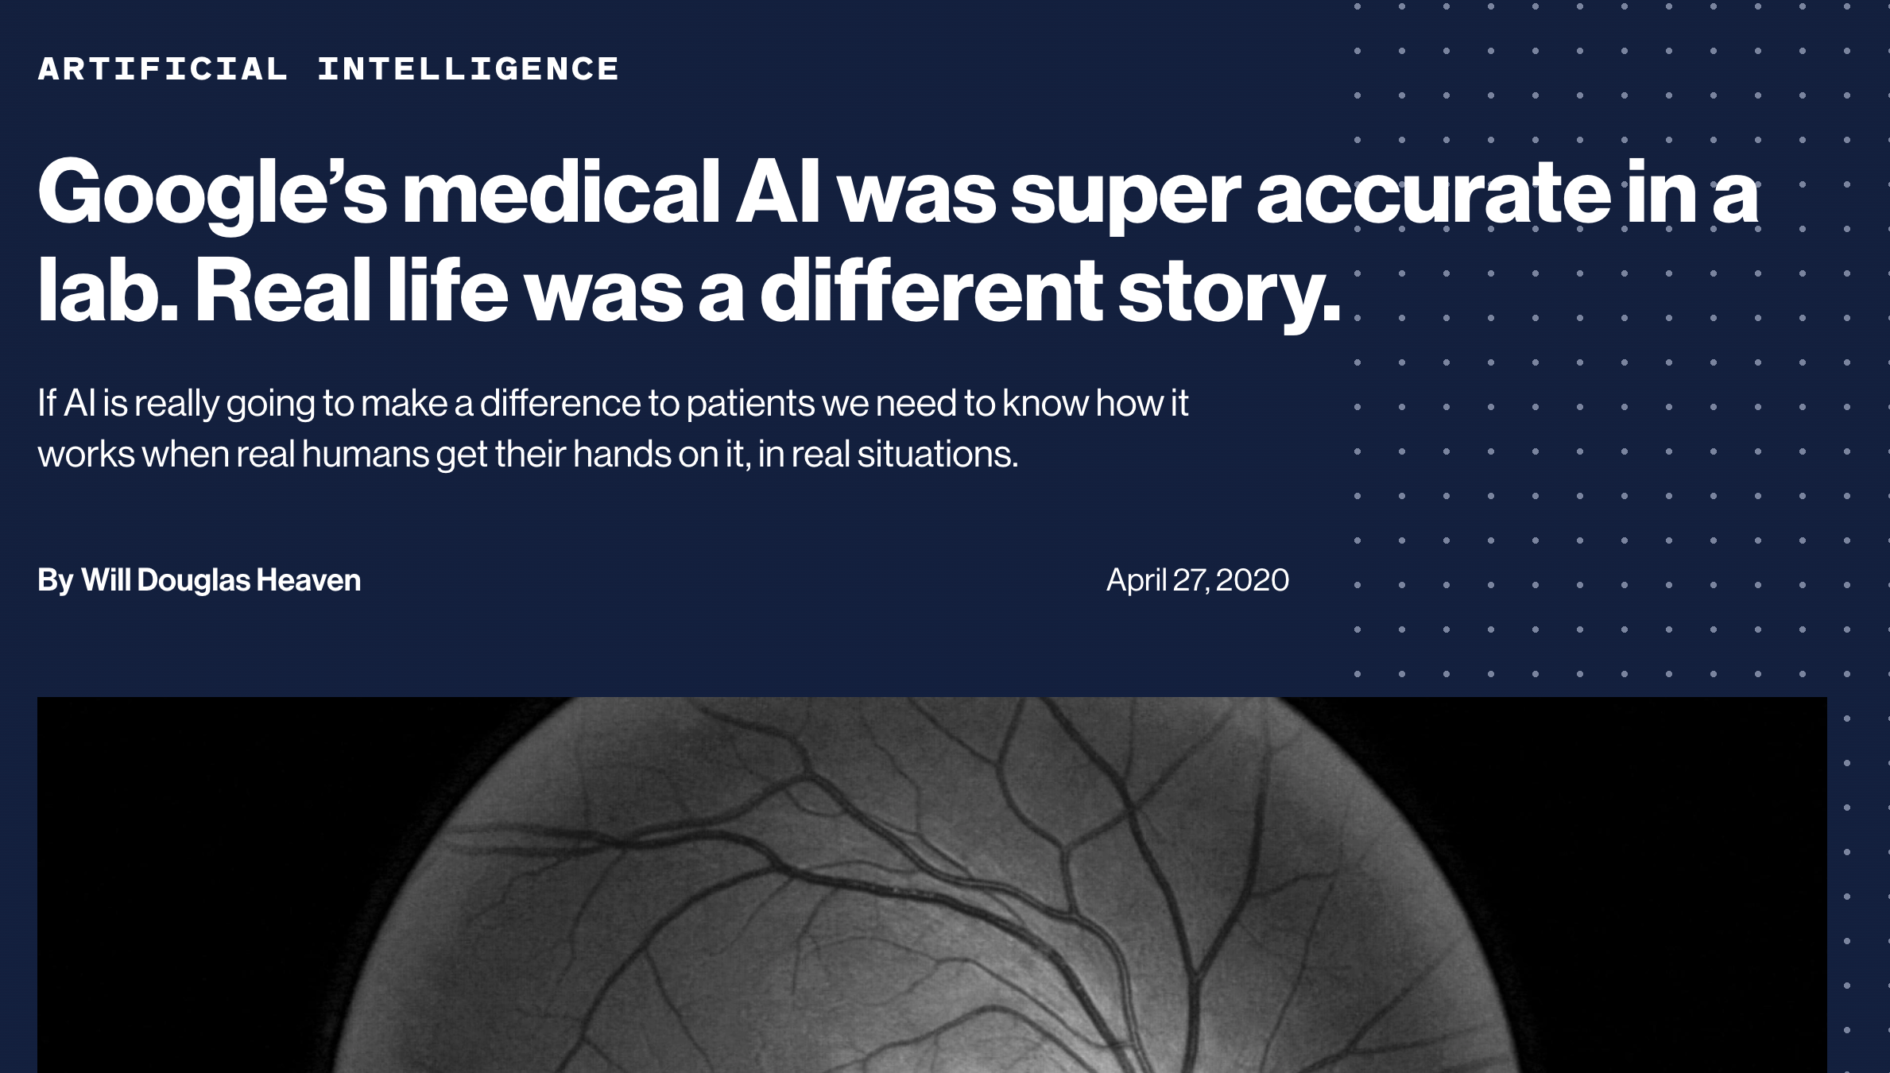
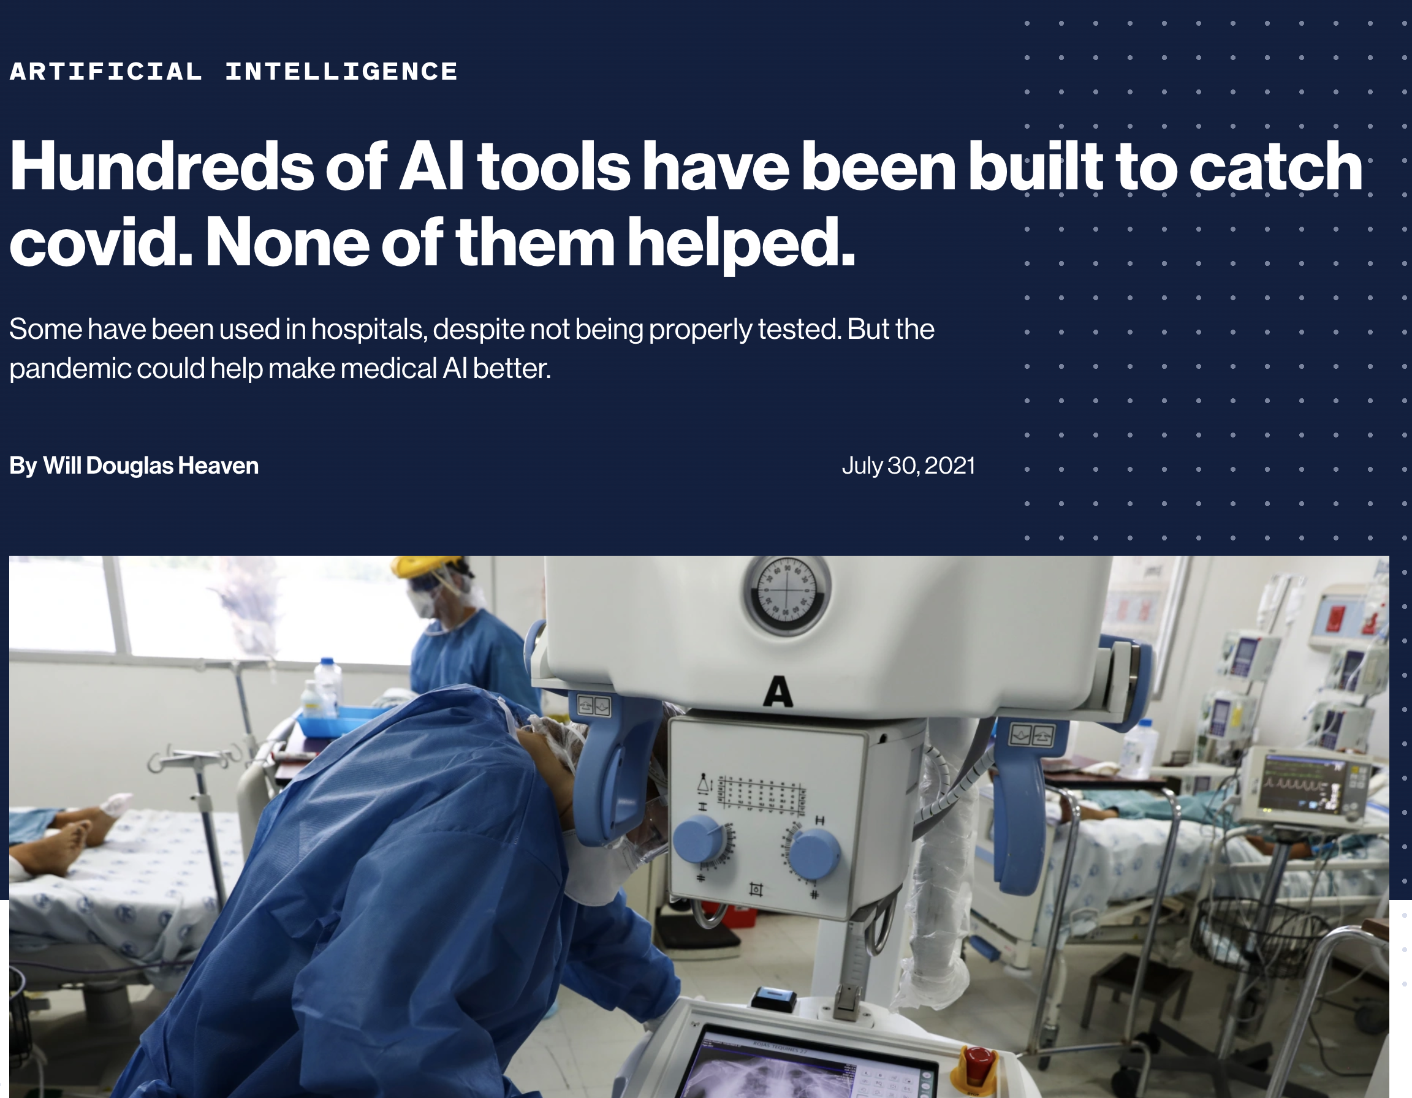
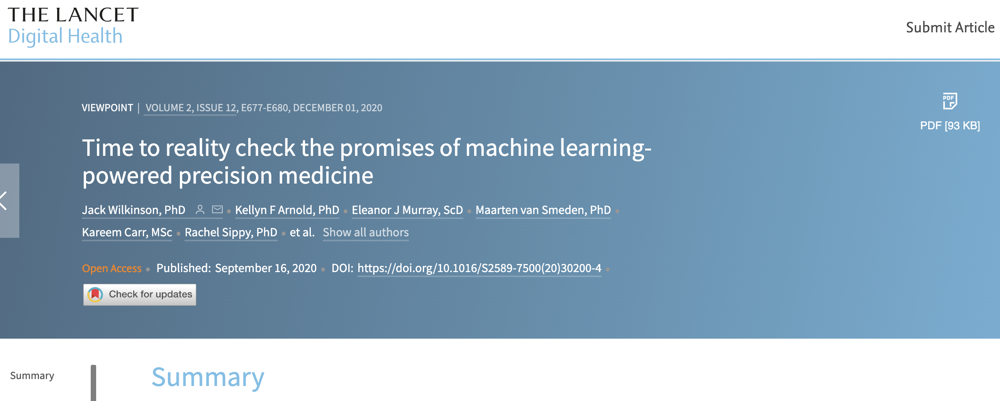
Real-world deployment

Slide 9
Real-world deployment
“This pandemic was a big test for AI and medicine. It would have gone a long way to getting the public on our side. But I don’t think we passed that test.”
— Derek Driggs apud Heaven 2021
“Unrealistic expectations encourage the use of these tools before they are ready.”
— Heaven 2021

Slide 10
Workflows
Overview

Slide 11
Patient workflow
“Workflow is the sequence of physical and mental tasks performed by various people within and between work environments.”
— AHRQ.gov

Slide 12

Automated diagnosis big “Wh”s
What
When
Where
in Whom
by Whom
for What

Slide 13


Slide 14

surely negative
uncertain cases
suspected positive

Slide 15


Slide 17
Workflows
Quantitative Issues

Slide 18
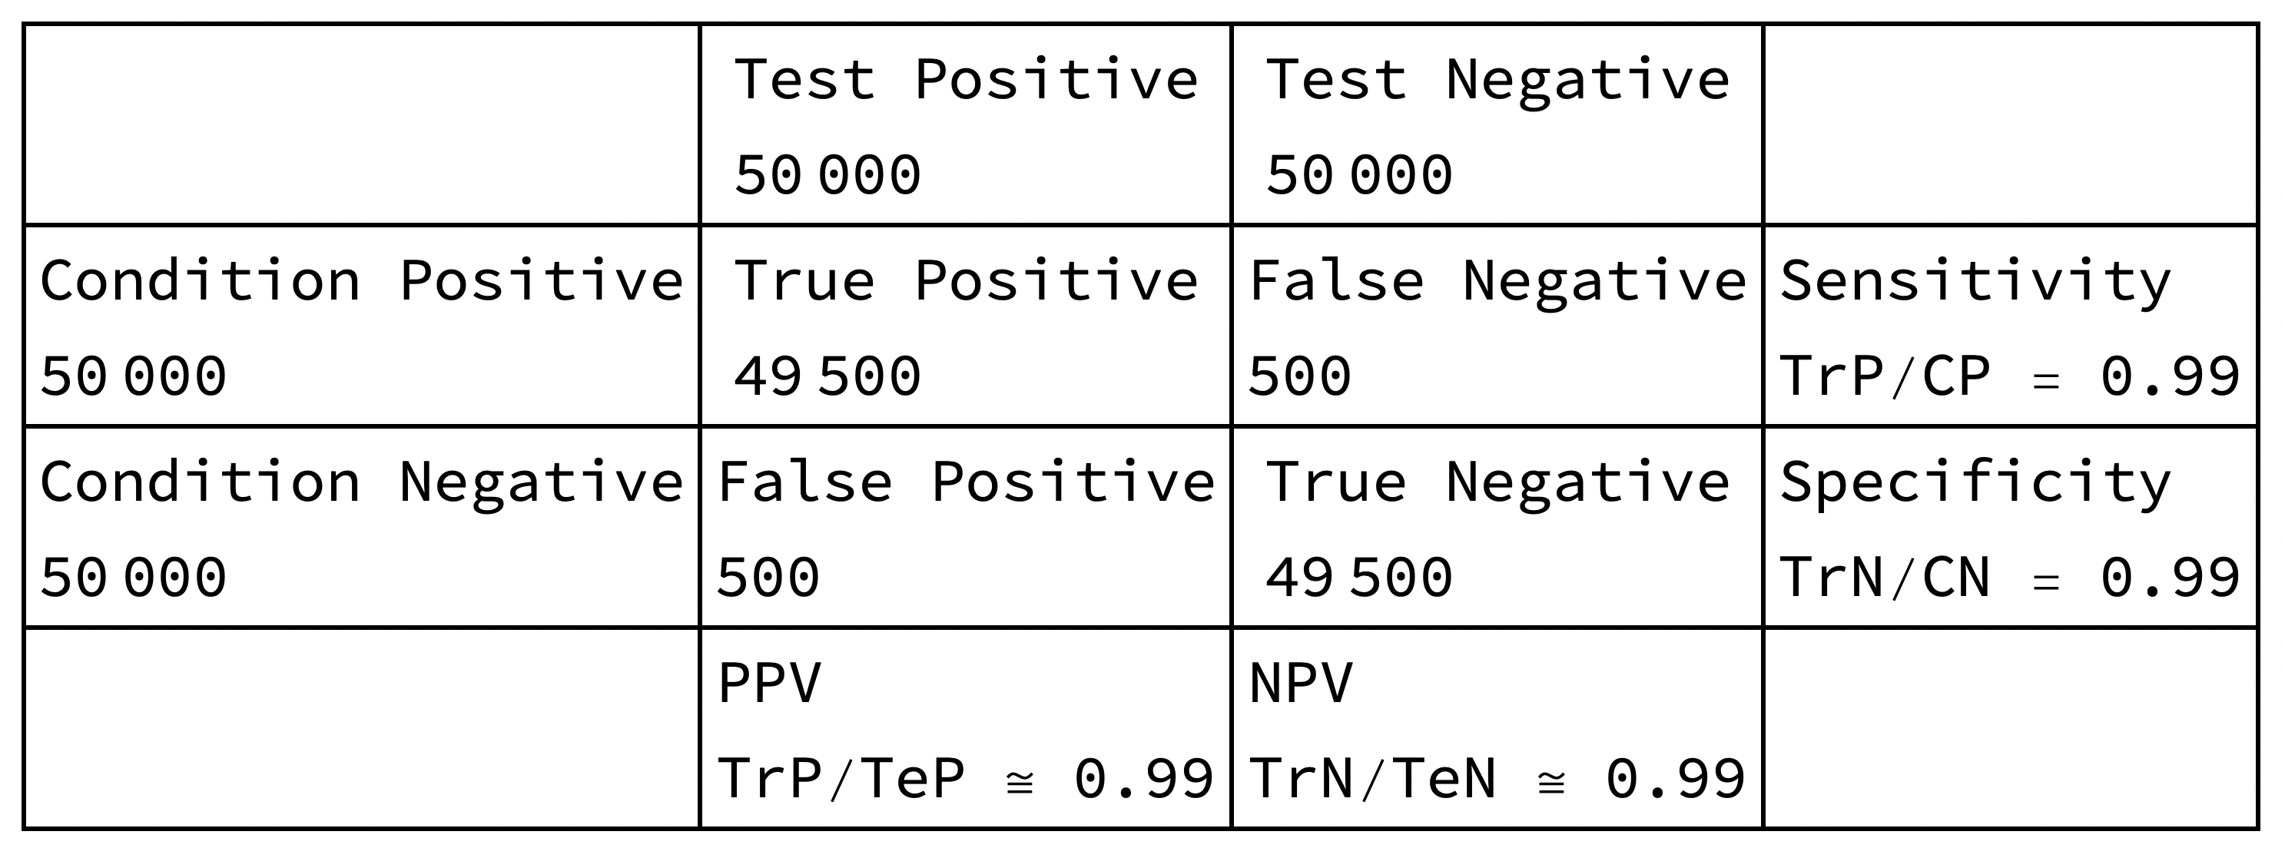
The fundamental problem of diagnostic tests

Slide 19
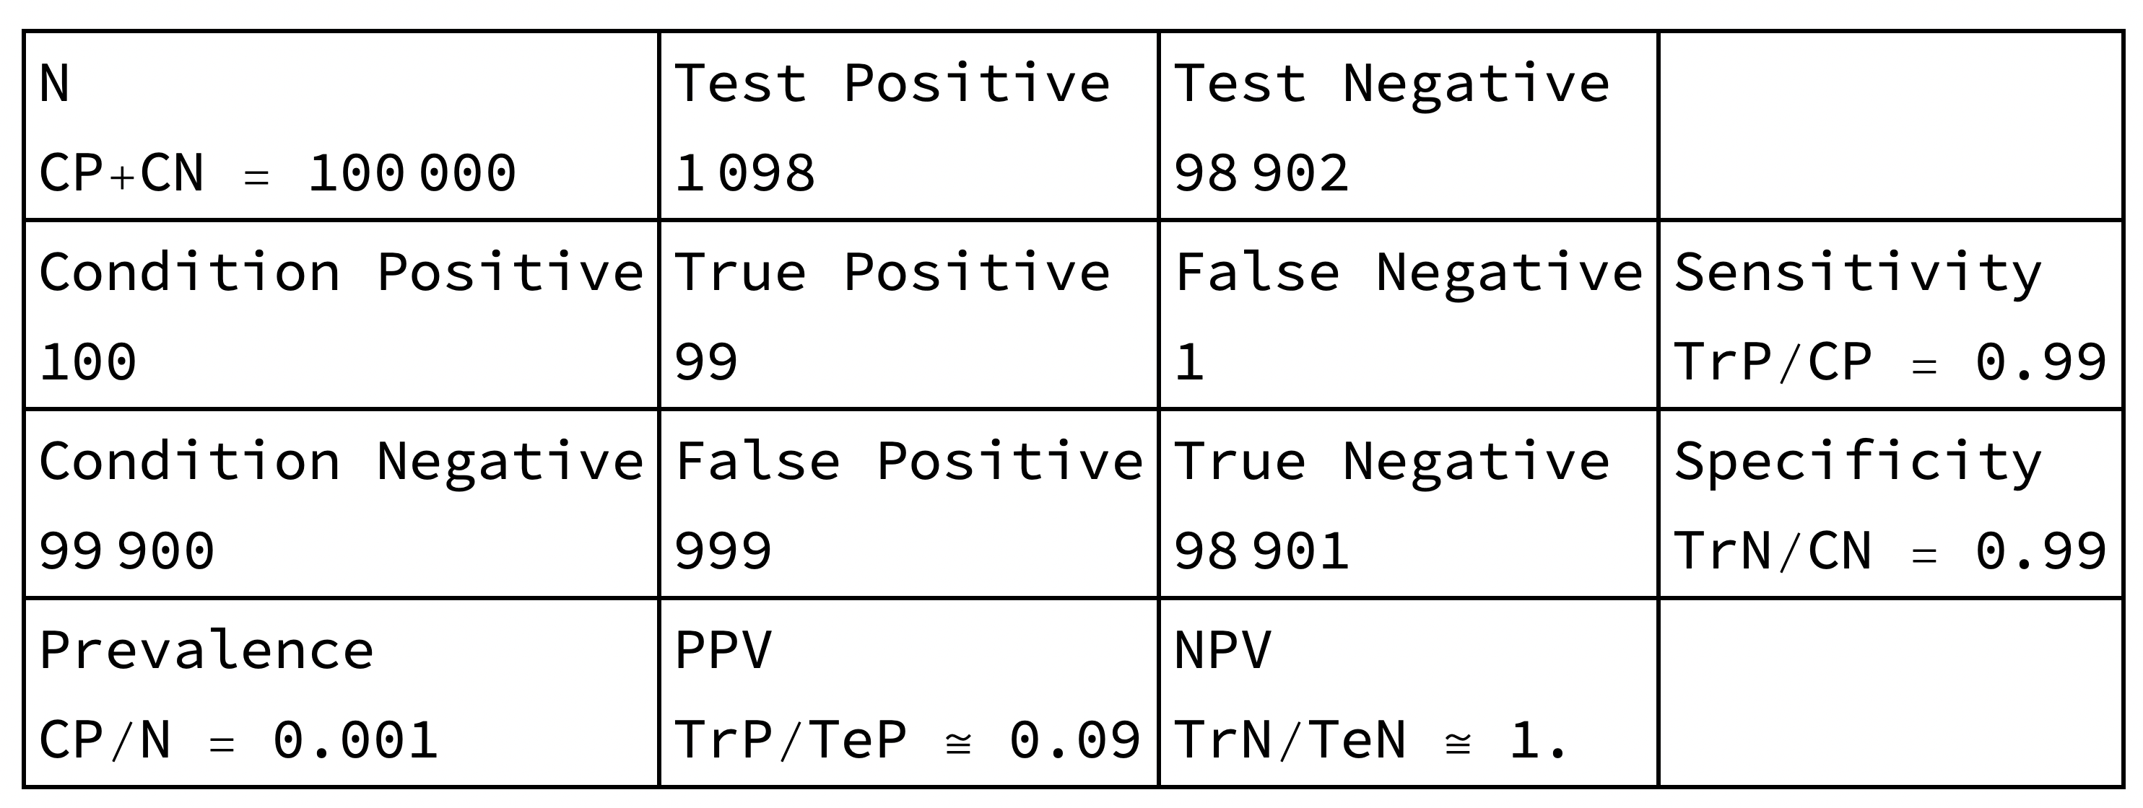
The fundamental problem of diagnostic tests

Slide 20
The fundamental problem of diagnostic tests
— What:
Melanoma? Basal cell carcinoma?
— When / Where / by Whom:
Primary care physician in routine visit?
Specialist after referral?
— for What:
Screening? Triage? Aid to diagnosis?
— in Whom:
Phototype I-II in Australia or Brazil?
Phototype V-VI in Denmark or Sweden?

Slide 21
Screening in general population
Screening in high-risk population or
Triage in pre-selected population

Slide 22
†NNT = 21 – 29.9
(English et al. 2004)
†NNT = 4.9 – 15.6
(Sidhu et al. 2011)
* | Men | Women
BCC | 1538 | 1191
SCC | 573 | 371
Mel. | 41 | 29
*Incidence per age-standardized 100 000/year for Australia Queenland 2011-2014 (BCC and SCC) and for Australia 2014 (Melanoma).
†All numbers for Australia from Marks et al., Wilkinson et al., Hansen et al., English et al., Baade et al., Marks et al., and Chia et al. apud Sidhu et al. 2011

Slide 23
Workflows
Beyond Quantitative Metrics

Slide 24
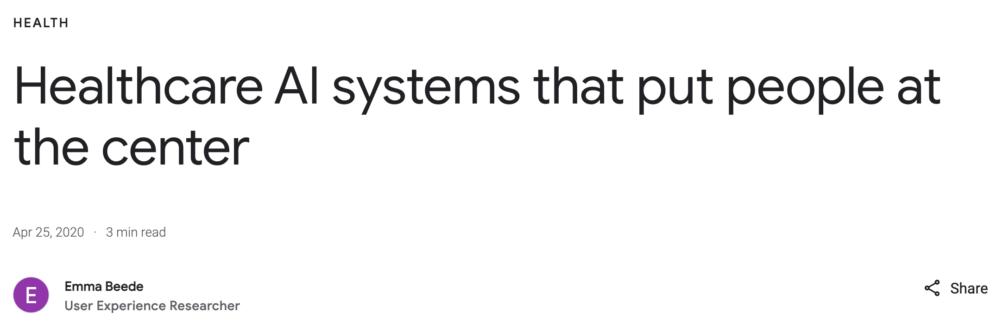
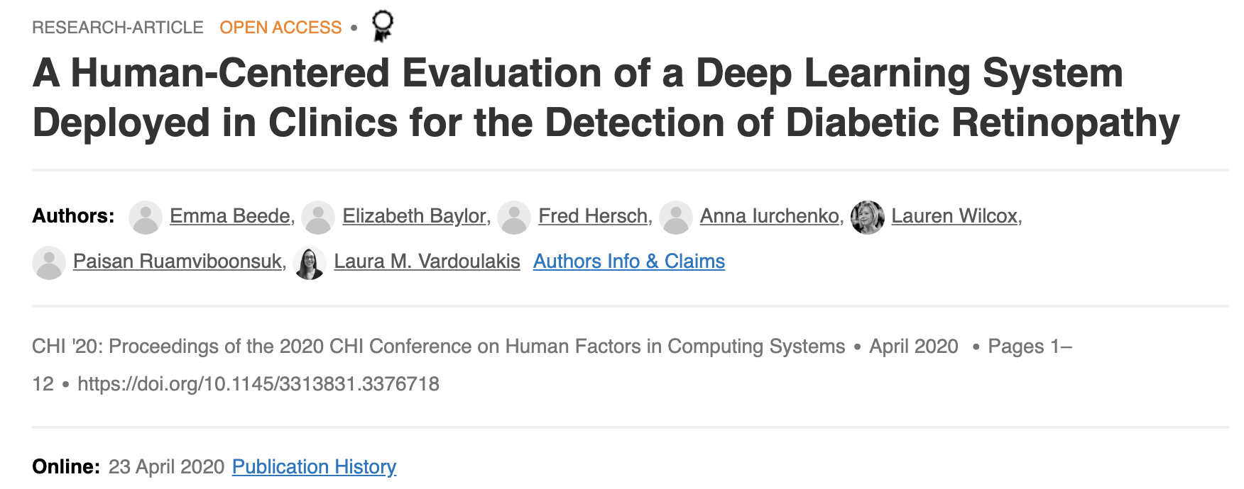
Case study: diabetic retinopathy

Slide 25
“One part of that journey is conducting user-centered research. Applied to healthcare, this type of research means studying how care is delivered and how it benefits patients, so we can better understand how algorithms could help, or even inadvertently hinder, assessment and diagnosis.”
— Beede 2020.

Slide 26
“With nurses scanning dozens of patients an hour and often taking the photos in poor lighting conditions, more than a fifth of the images were rejected. (...)
Nurses felt frustrated, especially when they believed the rejected scans showed no signs of disease and the follow-up appointments were unnecessary. They sometimes wasted time trying to retake or edit an image that the AI had rejected.”
— Heaven 2020.

Slide 27
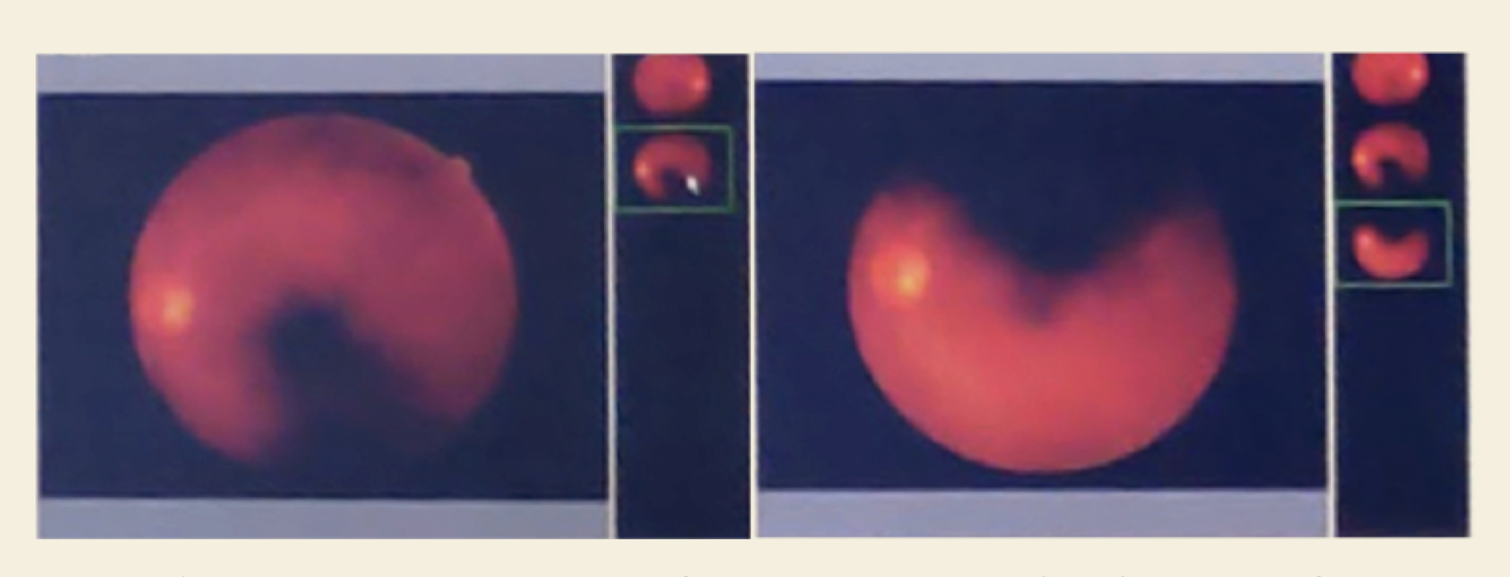
Beede et al. 2020

Slide 28
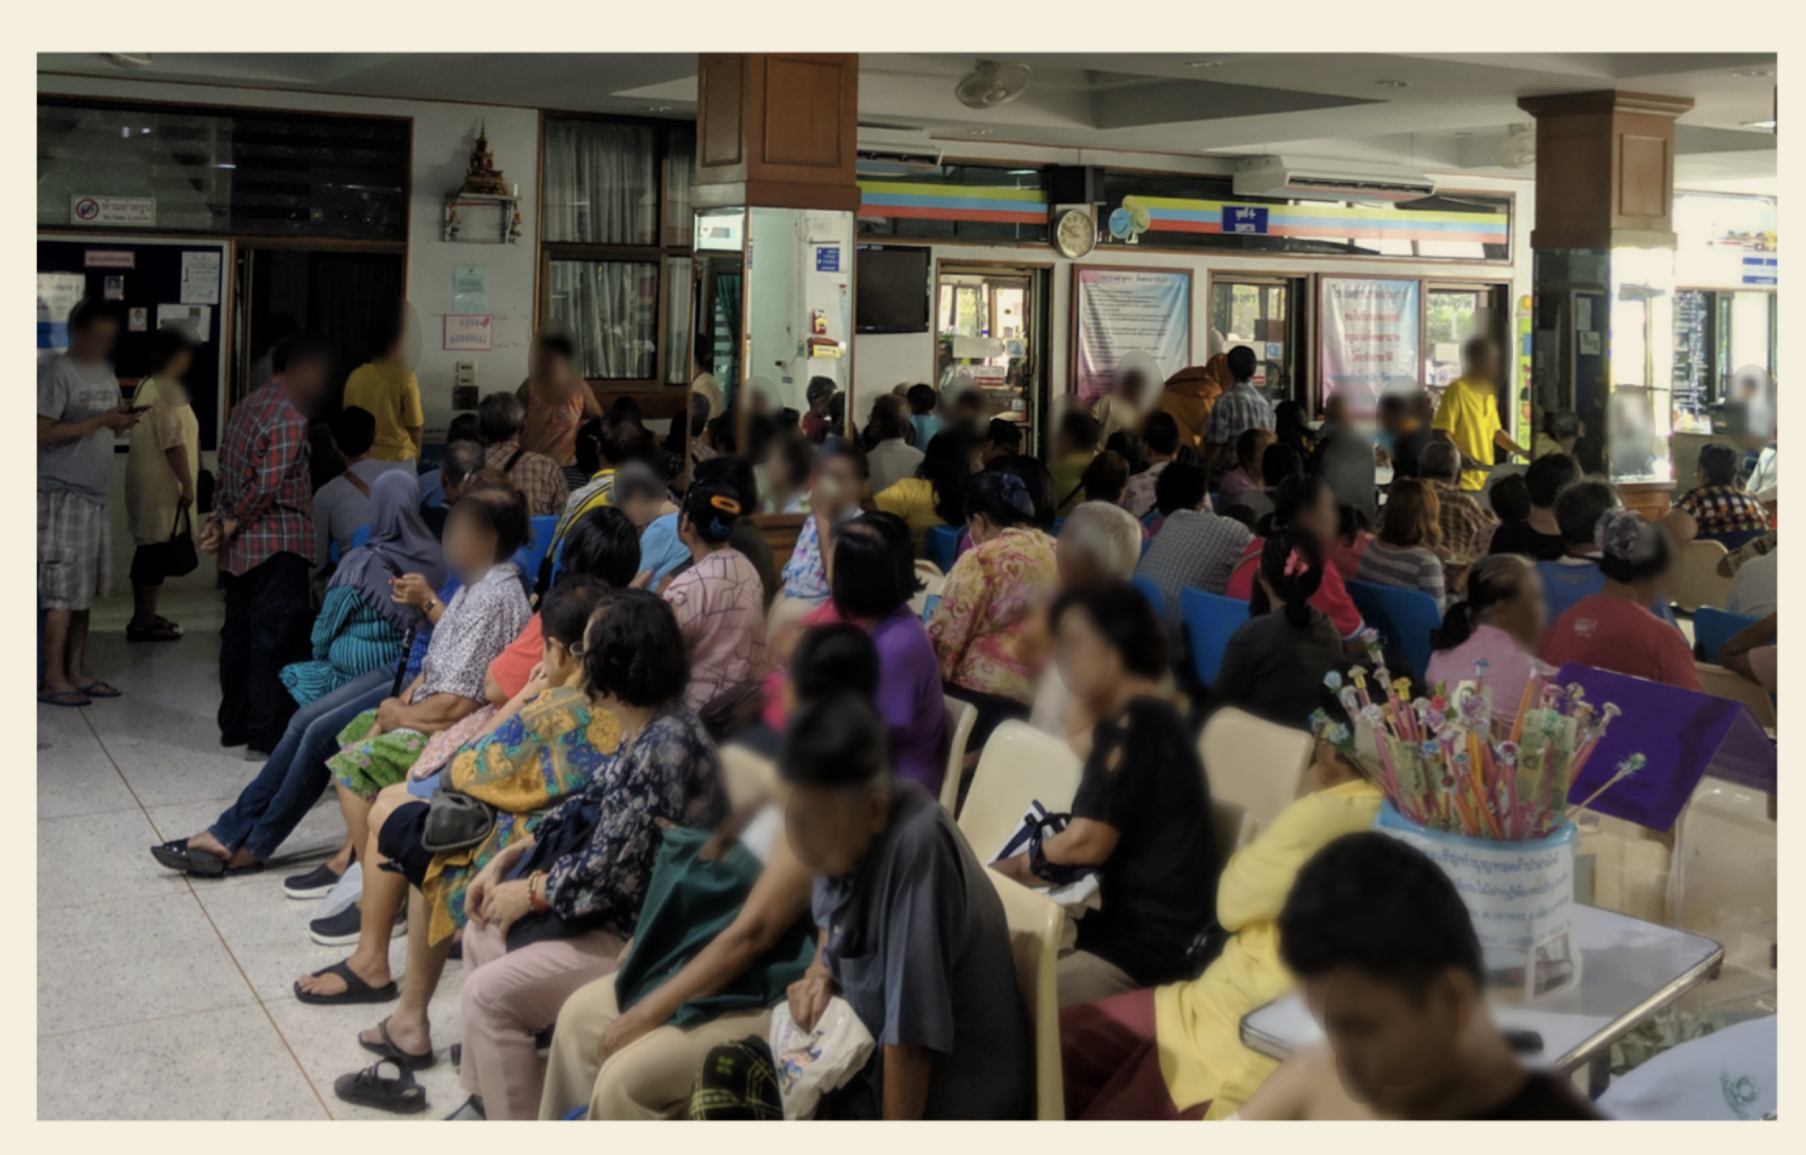
Beede et al. 2020

Slide 29
Alignment
Overview

Slide 30
Alignment in AI
“we need to be very careful in specifying what we want, because with utility maximizers we get what we actually asked for.
The value alignment problem is the problem of making sure that what we ask for is what we really want”
Russel & Norvig 2021

Slide 31
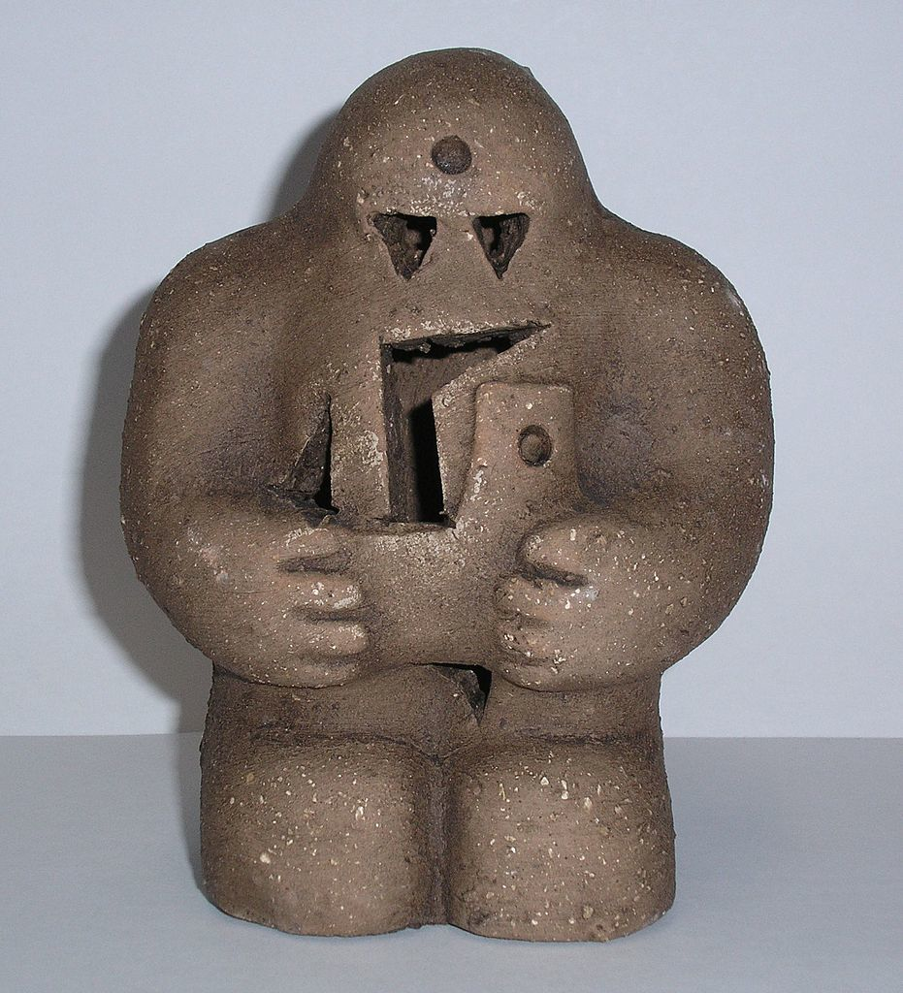

commons.wikimedia.org/wiki/File:Prague-golem-reproduction.jpg

Slide 32
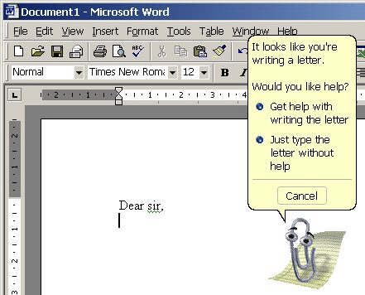

Slide 33
Misalignment in Computer Aided Diagnosis
“Nurses felt frustrated, especially when they believed the rejected scans showed no signs of disease and the follow-up appointments were unnecessary.”
— Heaven 2020.
“[Patients] are not concerned with accuracy, but how the experience will be—will it waste my time if I have to go to the hospital?”
— Beede et al. 2020.

Slide 34
Misalignment in Computer Aided Diagnosis
“(...) we observed nurses at clinics 4 and 5 dissuading patients from participating in the prospective study, for fear that it would cause unnecessary hardship.
(...) we observed nurses working around the prospective study protocol; relying on previous workflows and criteria for determining whether or not to refer the patient to a specialist.”
— Beede et al. 2020.

Slide 35
Misalignment in Computer Aided Diagnosis
“Of course, we don’t want an AI to make a bad call. But human doctors disagree all the time, he says—and that’s fine. An AI system needs to fit into a process where sources of uncertainty are discussed rather than simply rejected.”
— Heaven 2020.

Slide 36




Multiple stakeholders
Patients
Providers
Policymakers
Payors

Slide 37
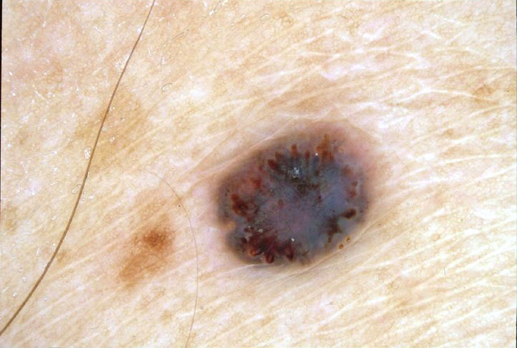
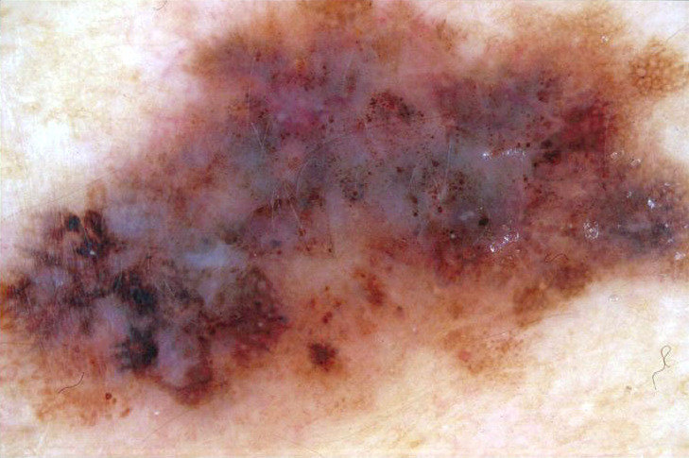
Alignment is about expectations
Atlas of Dermoscopy

Slide 38
Alignment is about consequences
“How do doctors make the decision to excise? Among the factors that may influence them are the concerns of patients (or family members) about malignancy (‘patient pressure to excise’), medicolegal worries about ‘missing’ a melanoma, economic benefits from performing excisions, and the likelihood, from epidemiological data, that a particular pigmented skin lesion might be a melanoma.”
English et al. 2004

Slide 39
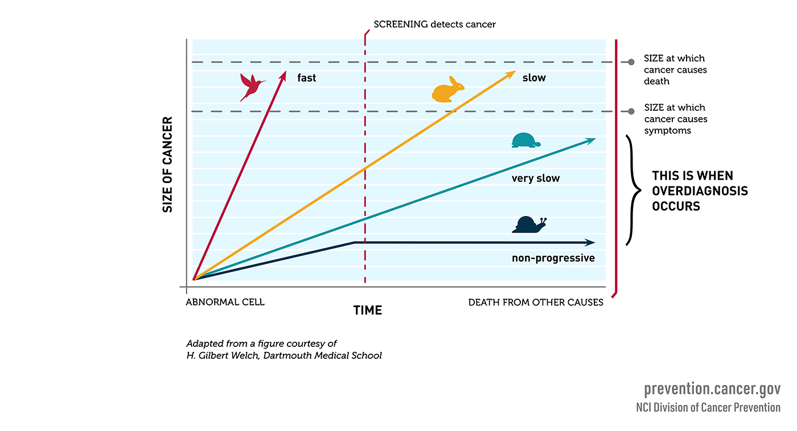
Cancer overdiagnosis

Slide 40
Reliability & Robustness

Slide 41
Reliability
Robustness
System delivers a consistent performance under its specified operating conditions.
System continues to function despite deviations of its operating conditions.
High availability
Accuracy
Frequent outages (“our network is out”)
Tolerance to small deviations
“Gracious failure”
Silent failure (insidious trash in/trash out)

Slide 42
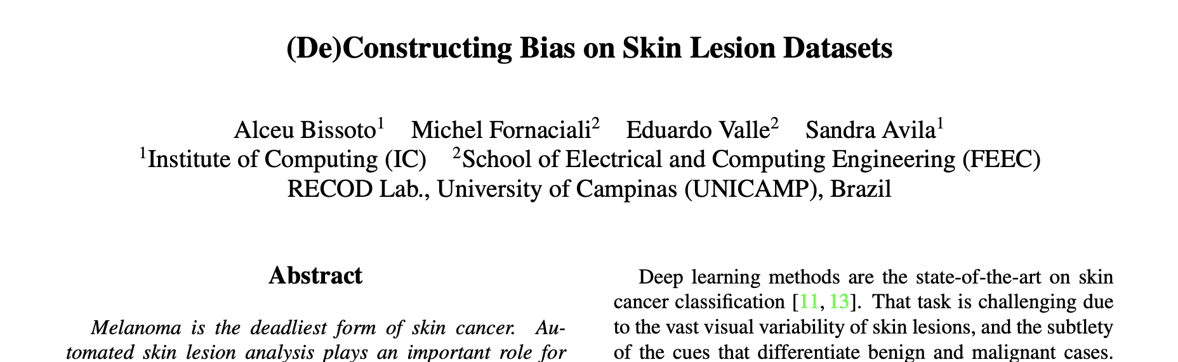
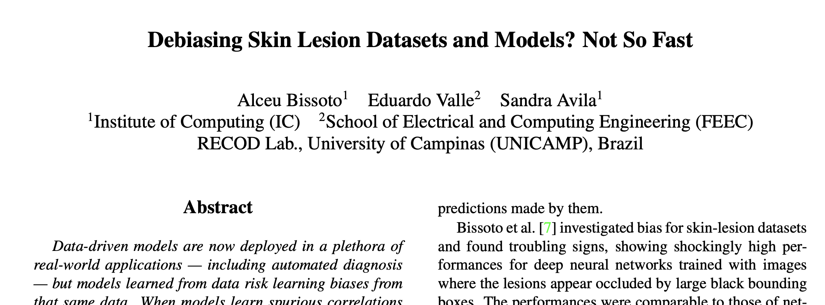
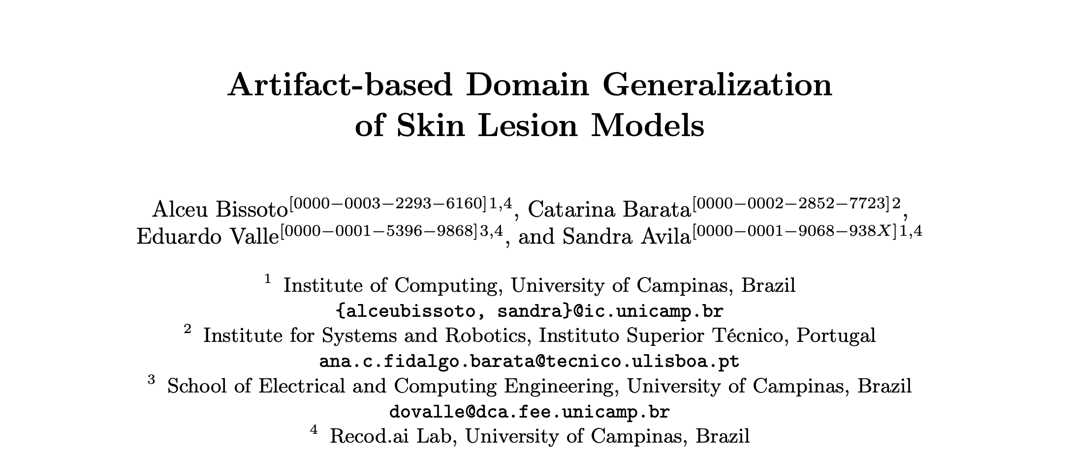
Dataset biases & OOD performance

Slide 43
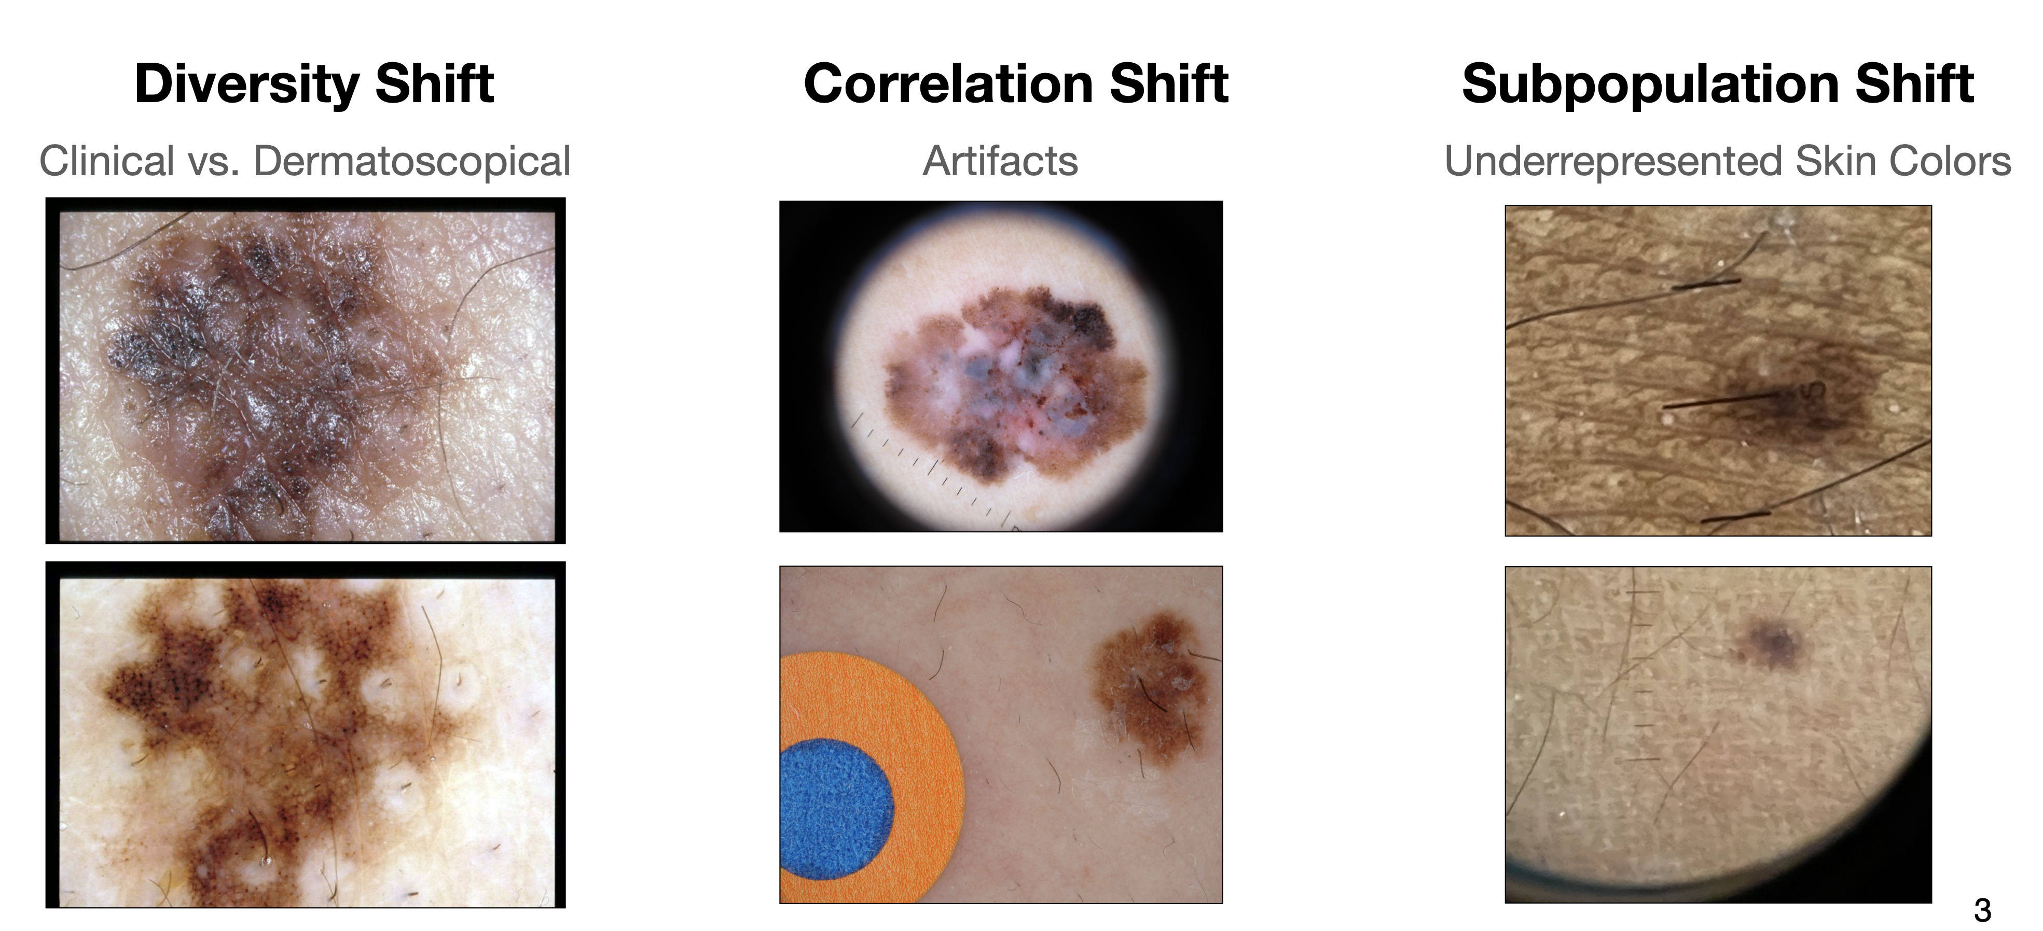
Bissoto et al. 2022

Slide 44
Real-world consequences: COVID-19
“Many unwittingly used a data set that contained chest scans of children who did not have covid as their examples of what non-covid cases looked like. But as a result, the AIs learned to identify kids, not covid.”
“Because patients scanned while lying down were more likely to be seriously ill, the AI learned wrongly to predict serious covid risk from a person’s position.”
“AIs were found to be picking up on the text font that certain hospitals used to label the scans. As a result, fonts from hospitals with more serious caseloads became predictors of covid risk.”
— Heaven 2021

Slide 45
Real-world consequences: COVID-19
“Errors like these seem obvious in hindsight. (...)
But many tools were developed either by AI researchers who lacked the medical expertise to spot flaws in the data or by medical researchers who lacked the mathematical skills to compensate for those flaws.”
— Heaven 2021

Slide 46






Slide 47
Real-world consequences: DR
“On a strong internet connection, these results appear within a few seconds. However, the clinics in our study often experienced slower and less reliable connections. (...)
In one clinic, the internet went out for a period of two hours during eye screening, reducing the number of patients screened from 200 to only 100.”
— Beede et al. 2020

Slide 48
Perspectives

Slide 49
Causal learning
Z
X
Y

Slide 50
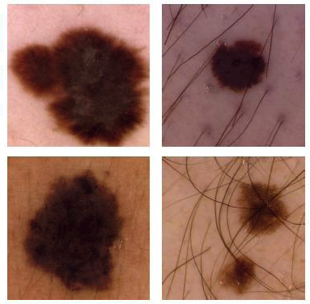
Causal learning
photo type
sex
progression
diagno sis
body site
IRMA dataset, Department of Medical Informatics, RWTH Aachen University.

Slide 51
“The simplest move would be for AI teams to collaborate more with clinicians. Researchers also need to share their models and disclose how they were trained so that others can test them and build on them. [That] would solve maybe 50% of the issues that we identified.”
— Derek Driggs apud Heaven 2021

Slide 52
Collaboration is hard!
Especially multidisciplinary collaboration
Especially with time-starved clinicians

Slide 53
“Academic researchers have few career incentives to share work or validate existing results. There’s no reward for pushing through the last mile that takes tech from 'lab bench to bedside’.”
— Bilal Mateen apud Heaven 2021

Slide 54
classical global descriptors & models
increased interest
deep neural networks
attempts at
real-world
deployment
1990s:
Image Processing Era
2000s:
Computer Vision Era
2010s:
Machine Learning Era
2020s:
?
first prototypes,
proofs-of-concept
local descriptors & bags of visual words
curated datasets & challenges
curated datasets & challenges

Slide 55
deep neural networks
attempts at
real-world
deployment
1990s:
Image Processing Era
2000s:
Computer Vision Era
2010s:
Machine Learning Era
2020s:
!
curated datasets & challenges
curated datasets & challenges
reshape the incentives towards collaboration, integration, and validation

Slide 56
Tracks to incentivize
Track | W | A | R&R
Acquisition of underrepresented data |  |  | ✓
Implementation of well-documented, reusable models |  |  | ✓
Prospective studies | ✓ | ✓ | ✓
Reproduction/evaluation/comparison of past models |  |  | ✓
Simulation of real-world scenarios | ✓ | ✓
Studies of case of actual or simulated deployment | ✓ | ✓
Use of specialist’s prior knowledge |  |  | ✓

Slide 57




Slide 58
Skin-Lesion Analysis: Three Proposals for the Decade
Eduardo Valle
RECOD Lab
University of Campinas, UNICAMP, Brazil

Slide 59
References

Slide 60
Adamson et al. "Screening for melanoma in men: a cost-effectiveness analysis." J. Gen. Internal Med. 2019-11.
Beede et al. "A human-centered evaluation of a deep learning system deployed in clinics for the detection of diabetic retinopathy." ACM CHI 2020.
Beede. "healthcare AI systems that put people at the center." Google Technology Blog, 2020-04-25.
Bissoto et al. "Artifact-based domain generalization of skin lesion models." ECCV/ISIC Workshop 2022.
Bissoto et al. "Debiasing skin lesion datasets and models? Not so fast." CVPR/ISIC Workshop 2020.
Bissoto et al. "GAN-based data augmentation and anonymization for skin-lesion analysis: a critical review." CVPR/ISIC Workshop 2021.
Borzyskowski et al. (Ed.). "Data science and AI in the age of COVID-19." The Alan Turing Institute.
Chen et al. "A comparison of dermatologists’ and primary care physicians’ accuracy in diagnosing melanoma.” Arch. dermatology v. 137 2001.
D'Amour et al. "Underspecification presents challenges for credibility in modern machine learning." JMLR v. 23 2022.
Ek et al. "Clinical diagnosis of skin tumours: how good are we?", ANZ J. Surg 2005.
English et al. "Factors influencing the number needed to excise: excision rates of pigmented lesions by general practitioners." MJA 2004.
Geller et al. "Screening, early detection, and trends for melanoma: current status (2000-2006) and future directions". J. Am. Acad. of Dermatology v. 57 2007-10.
Hallock & Lutz. "Prospective study of the accuracy of the surgeon's diagnosis in 2000 excised skin tumors.” Plastic and reconstr. surg. v. 101 1998./
Heaven. "Hundreds of AI tools have been built to catch COVID. None of them helped." MIT Tech Review, 2021-07-30.
Hendrycks et al. "The many faces of robustness: a critical analysis of out-of-distribution generalization." ICCV 2021.

Slide 61
Kompa et al. "Second opinion needed: communicating uncertainty in medical machine learning". NPJ Digital Medicine 2021.
Lallas et al. "Reasons for excision of skin tumors: a one-year prospective study in a tertiary skin cancer unit." Dermatology 2015-02-12.
Leiter et al. "Epidemiology of skin cancer." in Richrath (ed.) Sunlight, Vitamin D, and Skin Cancer, 2nd ed. Landes & Springer 2014.
Leiter et al. "Epidemiology of skin cancer: update 2019" in Richrath (ed.) Sunlight, Vitamin D, and Skin Cancer. Landes & Springer 2020.
Marwaha et al. "Comparative effectiveness study of faceto-face and teledermatology workflows for diagnosing skin cancer". J. Am. Acad. of Dermatology 2019-02.
Mirikharaji et al. "A survey on deep learning for skin lesion segmentation." arXiv preprint 2022-06-01.
Pellacani et al. "Reflectance confocal microscopy as a second-level examination in skin oncology improves diagnostic accuracy and saves unnecessary excisions: a longitudinal prospective study." British J. of Dermatology 2014.
Perez et al. "Data augmentation for skin lesion analysis." MICCAI/ISIC Workshop 2018.
Pires et al. "A data-driven approach to referable diabetic retinopathy detection." AI in Medicine v. 96 2019.
Salerni et al. "Meta-analysis of digital dermoscopy follow-up of melanocytic skin lesions: a study on behalf of the International Dermoscopy Society." J. Europ. Acad. of Dermatology and Venereology 2013.
Sambasivan et al. "'Everyone wants to do the model work, not the data work': Data Cascades in high-stakes AI". ACM CHI 2021.
Sidhu et al. "The number of benign moles excised for each malignant melanoma: the number needed to treat." Clin. & Exp Dermatology, v. 37 2011.
Tschandl et al. "Human–computer collaboration for skin cancer recognition." Nature Medicine Letters v. 26 2020-08.
Valle et al. "Data, depth and design: learning reliable models for skin lesion analysis." Neurocomputing v. 383 2020.
Wilkinson et al. "Time to reality check the promises of machine learningpowered precision medicine". The Lancet Digital Health v. 2 2020-12.

